Slide 1
How to record your voice
For ePoster MP3 Podcast

Slide 2
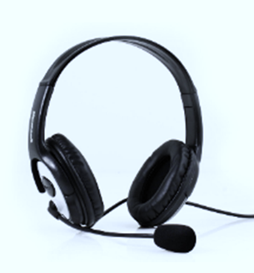
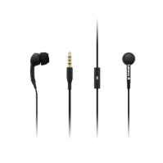
Contents
Using a Windows 10 computer to record
Using a Mac computer to record
Record with an Android phone
Record with an iPhone/iPad
We recommend using a computer with a headset attached to it
If you don’t have a headset, and you are using the internal microphone of your computer, please be as close as possible to your laptop and speak in a loud, clear voice.
Please avoid moving when you are recording to prevent volume differences and noises during your recording.

Slide 3

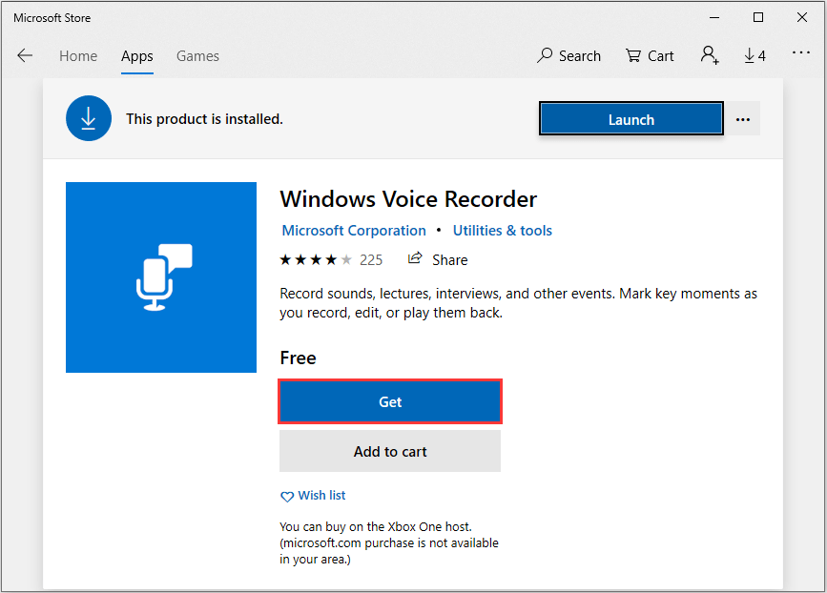
Using a Windows 10 Computer to Record
Step 1: Click Start and then select Microsoft Store.
Step 2: Search for Windows Voice Recorder and click the app in the search result.
Step 3: Click Get to download Voice Recorder.
Or you can download the app directly Click here
Once you download Voice Recorder, it will be automatically
installed and then you can use it to record your audio.

Slide 4
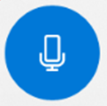

Using a Windows 10 Computer to Record
Step 4: To make your vocal recording, be sure to connect a microphone and follow these steps. Click Start and type Voice Recorder in the search box. Then click the app to open it.
Step 5: Click the Record button or press Ctrl + R to start recording.
Step 6: Click the Stop button to finish recording when you have completed your recording.

Slide 5
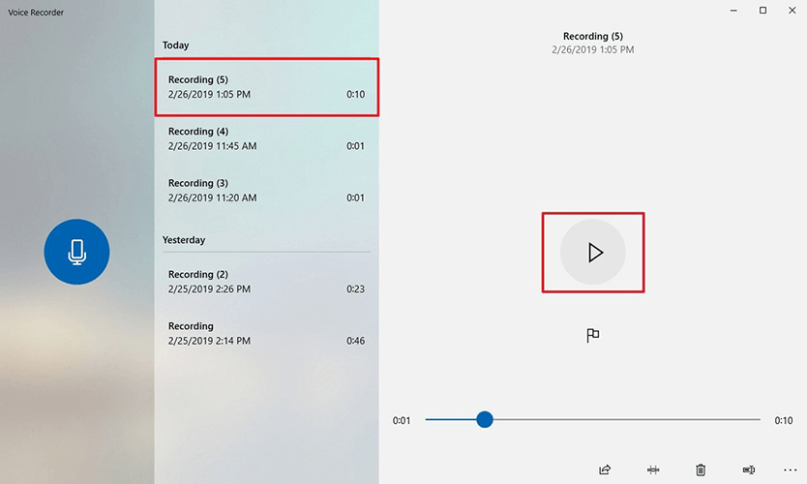
Using a Windows 10 Computer to Record
Step 7: In Windows Voice Recorder, all recordings will be listed in the left panel.
If you want to check the audio you have recorded, select it from the panel and click the Play button.
Step 8: The audio file will usually be stored in the Documents folder > Sound Recording.
Please rename the file. Ensure there are no characters, symbols or spaces – only text in the file name.
You can also right click on the recording in the Voice Recorder app and choose open file location to find your audio file.

Slide 6

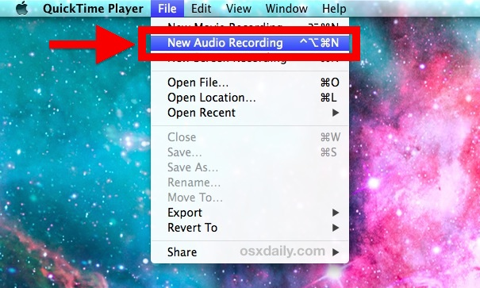
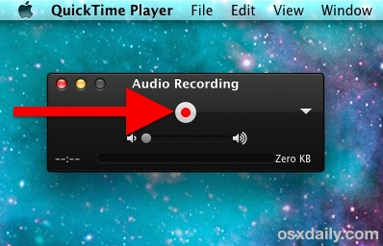
Using a Mac Computer to Record
You can record audio on a Mac with this method, using either a built-in microphone or an external mic.
Step 1: Open QuickTime Player, found in the /Applications/ folder.
Step 2: Click the File menu and choose New Audio Recording.
Step 3: Click the red (o) Record button to start recording audio from the default microphone source. When finished, click the same button to stop the recording.

Slide 7
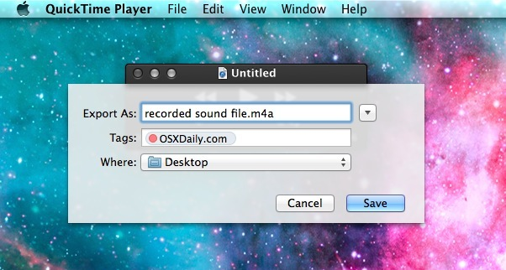
Using a Mac Computer to Record
Step 4: Go to the File menu and select Save. Name the file and choose your file location.
Please note that you may NOT save the file name with any characters, symbols or spaces – only text.
Another option for recording in Mac OS can be found online here: Click here

Slide 8
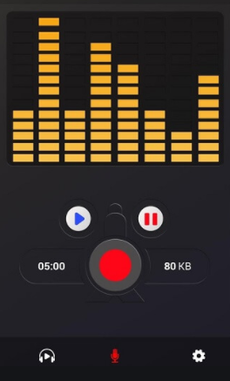
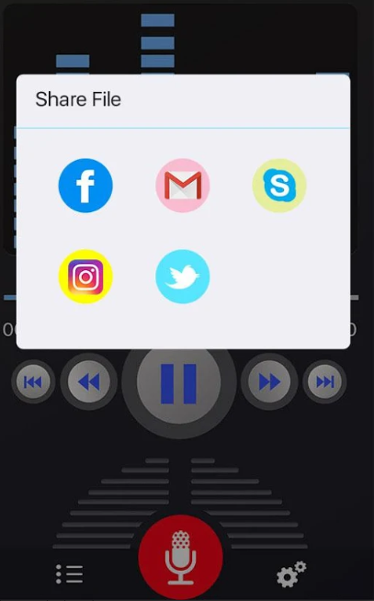
Recording with an Android Phone
This method should only be used if the method of using a computer is not possible.
To record using your phone you can use the app Voice Recorder, available for free on Google Play via this link: Click here
Step 1: Click the recording button to record your voice:
Step 2: After you finish recording, we recommend you select Share File and send it to your own email, and then save it in a convenient location.

Slide 9
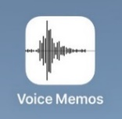
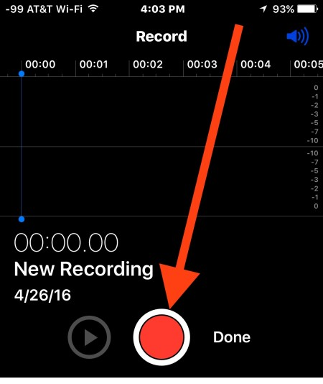
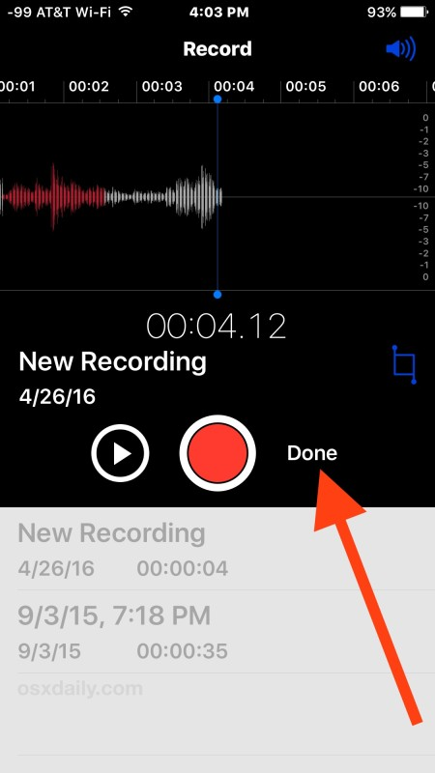
Record with an iPhone/iPad
Step 1: Open the Voice Memos app located on the iPhone/iPad.
Step 2: Tap the red record button to start recording your voice or audio. Tap the same button again when finished, in order to stop recording.
Step 3: When satisfied with the recording, tap Done.

Slide 10
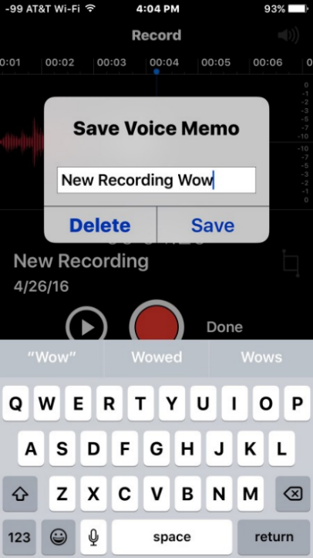
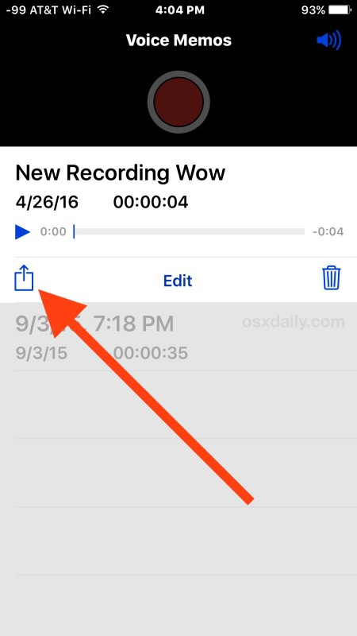
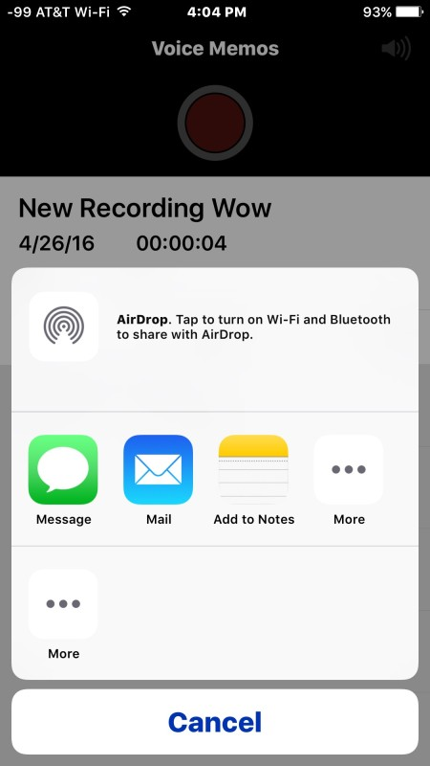
Record with an iPhone/iPad
Step 4: Save the voice recording and give it a name.
Please note that you may NOT save the file name with characters, symbols or spaces – use only text.
Step 5: Share the Voice Recording
from your iPhone.

