Slide 1
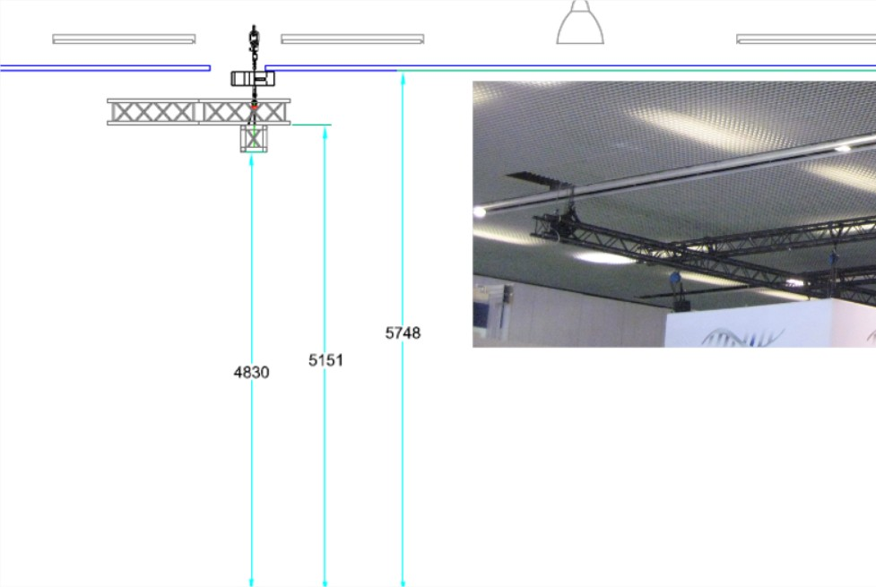
6.85m
Max height allowed 6m
Hanging item
12.05m
Stand

